Slide 1
BITCOIN Opportunities and Risks
CHENG Ka Yi 54297110
CHAU, Tsz Yau 53053443
ZOU, Luoyi 54017313

Slide 2
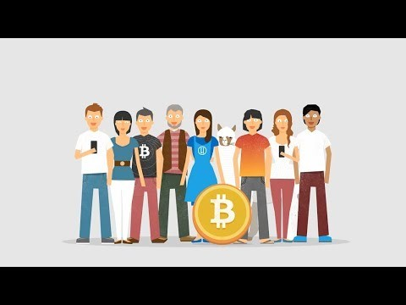
INTRODUCTION What is Bitcoin How Bitcoin works
https://youtu.be/Gc2en3nHxA4

Slide 3
INTRODUCTION How are Bitcoin obtained
Exchange conventional money on an online exchange
Exchange for the sale of goods or services
Acquire by serving as miner

Slide 4
INTRODUCTION Are Bitcoin Transaction Anonymous
Not truly anonymous
Transaction falls between anonymous and non-anonymous

Slide 5
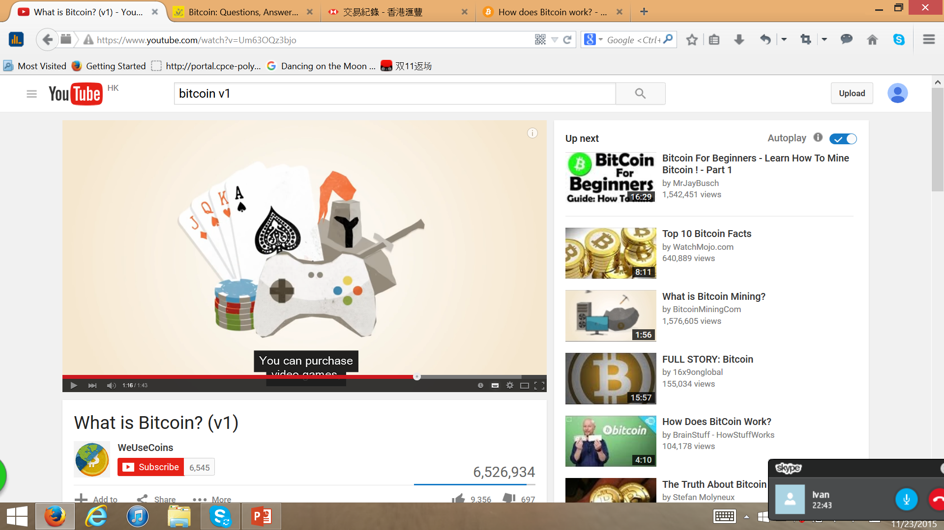
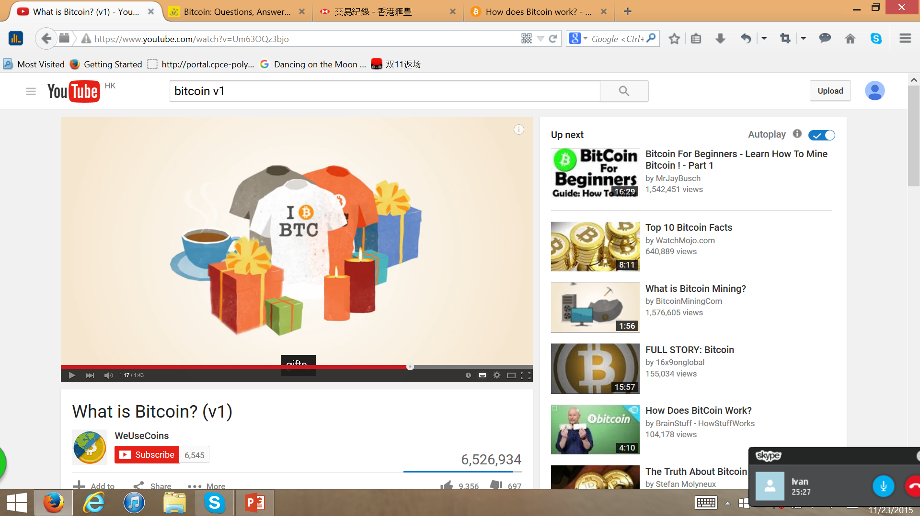
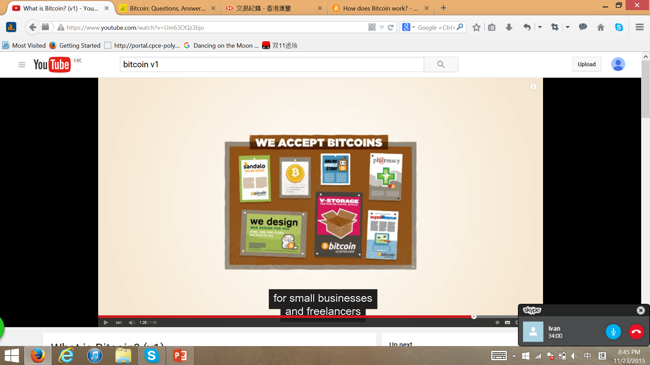
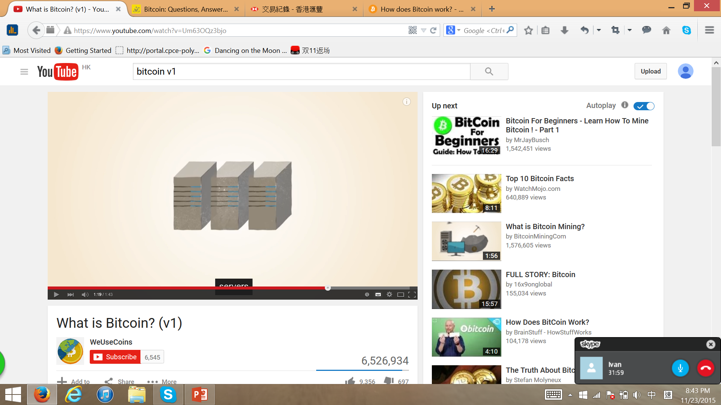
INTRODUCTION Basic usages of Bitcoin
Online / Physical stores
Personal stuff
Bitcoin gift card

Slide 6
Opportunities Brought by Bitcoin
Usage and Advantage of Bitcoin
Individual
Businesses

Slide 7
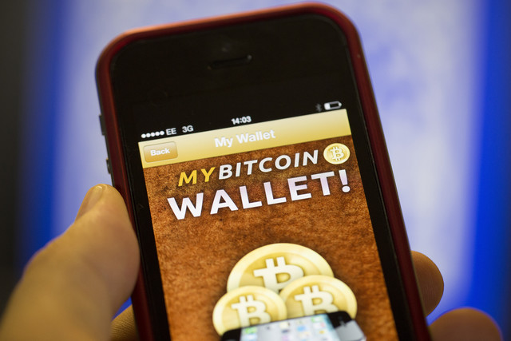
Bitcoin for Individual
Mobile Payments Made Easy
Two step scan-and-pay
No sign up, swiping cards, PIN, sign
Just display the QR code in the Bitcoin wallet app

Slide 8
Bitcoin for Individual
Security and Control Over Your Money
Bitcoin transactions are secured by military grade cryptography
No one can charge money/make payment on your behalf
Against many types of fraud
Works Everywhere, Anytime
No need to use the same software/same service providers
Bitcoin network never stops

Slide 9
Bitcoin for Individual
Fast International Payments
Protect Your Identity
Able to send a payment without revealing your identity, just like with physical money
No banks to make you wait 3 business days
No extra fees for making international transfer
No special limitations on the min/max amount you can send

Slide 10




Bitcoin for Businesses
Get Free Visibility
Accepting bitcoin is a good way to get new customers
Give your business some new visibility
Clever practice for online business

Slide 11
Bitcoin for Businesses
Multi-Signature
A feature which allows bitcoins to be spent only if a subset of a group of people authorize the transaction
Can be used by a board of directors to prevent any member to make expenditures without enough consent
To track which member allowed each payment
Accounting Transparency
Can provide information your members can use to verify your balances and transactions
Non-profit organizations can allow the public to see how much donations they receive
Highest level of transparency

Slide 12
Further Development and Application of Bitcoin
Bitcoin has many features and opens many possibilities that the community is still exploring.
There are some technologies currently being researched and in some cases, turned into real products and services.

Slide 13
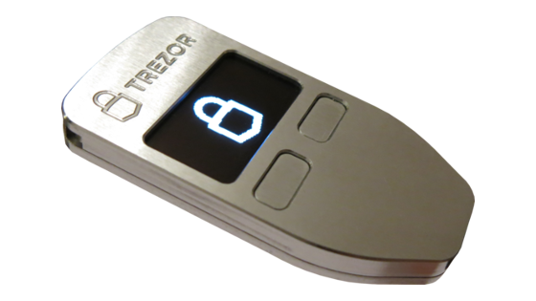
Further Development and Application of Bitcoin
Control Against Fraud
Protection against most prevalent frauds like chargebacks (return of funds to a consumer) or unwanted charges
Users can backup / encrypt their wallet and hardware wallets are very difficult to steal or lose money in the future

Slide 14
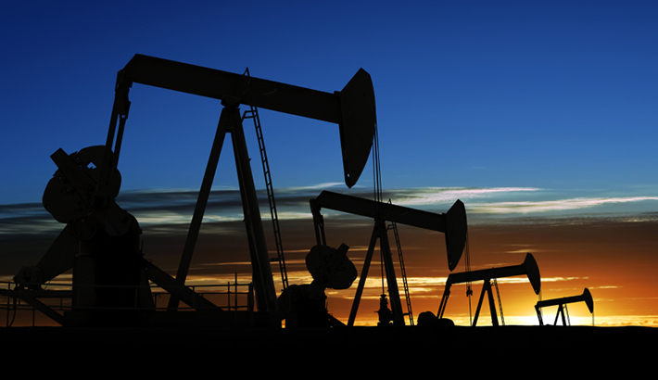
Further Development and Application of Bitcoin
Global Accessibility
Bitcoin is available in a large number of countries that still remain out of reach for most payment systems due to their own limitations
Increase global access to commerce and it can help international trades to flourish
E.g. middle eastern countries start to trade petroleum using bitcoin

Slide 15

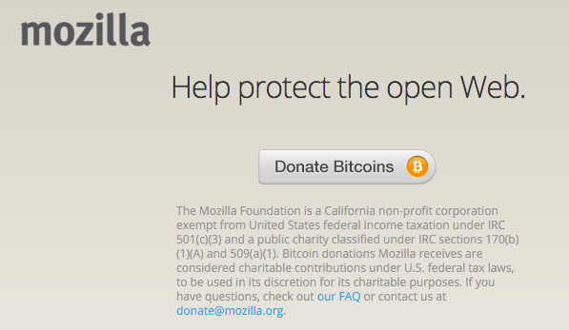
Further Development and Application of Bitcoin
Tips and Donations
Sending a payment only requires one click and receiving donations can be as simple as displaying a QR code
In case of emergencies, Bitcoin donations could contribute a faster international response
More and more organizations are accepting bitcoin donations

Slide 16
Further Development and Application of Bitcoin
Investments
There are multiple Bitcoin-Currency exchange platform trading 7x24 around the world, with robust trading API provided.
The relative low trading fraction(fees and charges), low entry barrier, and highly transparent information makes Bitcoin popular among individual and institutional investors.
A variety of financial derivatives is being invented such as Options(期權), Futures(期貨), and Swaps(掉期), to further promote the market efficiency.

Slide 17
Further Development and Application of Bitcoin
Investments
The Bitcoin market is becoming mature.
Electronic-Traded Fund listed on the market.[GBTC:US]
Many technology and consulting company are developing their Bitcoin related services.

Slide 18
'$$$$$$$$::'$$$$::'$$$$$$::'$$:::'$$::'$$$$$$::
$$.... $$:. $$::'$$... $$: $$::'$$::'$$... $$:
$$:::: $$:: $$:: $$:::..:: $$:'$$::: $$:::..::
$$$$$$$$::: $$::. $$$$$$:: $$$$$::::. $$$$$$::
$$.. $$:::: $$:::..... $$: $$. $$::::..... $$:
$$::. $$::: $$::'$$::: $$: $$:. $$::'$$::: $$:
$$:::. $$:'$$$$:. $$$$$$:: $$::. $$:. $$$$$$::
..:::::..::....:::......:::..::::..:::......:::

Slide 19
~/Information Security Risks
./Cyber Theft
./Ransomware

Slide 20
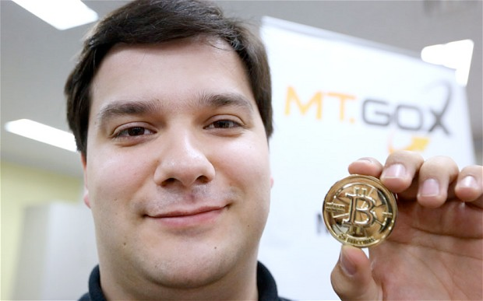

Slide 21
Mt. Gox>
$ WAS the world’s biggest BTC exchange.
$ Suspended trading and then shut down in 2014
->850,000 BTCs were reported STOLEN
->More than USD450,000,000 at that time

Slide 22
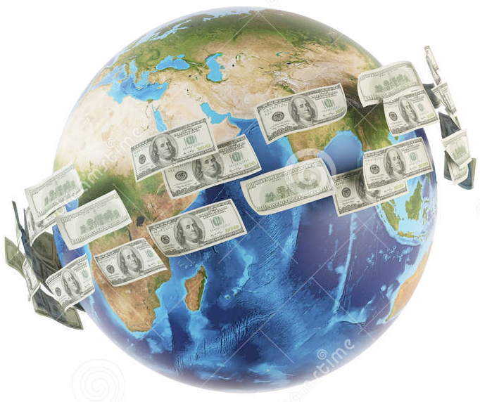
850,000BTC
- If we sell all the lost coins and get 100HKD notes, the notes can wrap around the world for
14 rounds!

Slide 23
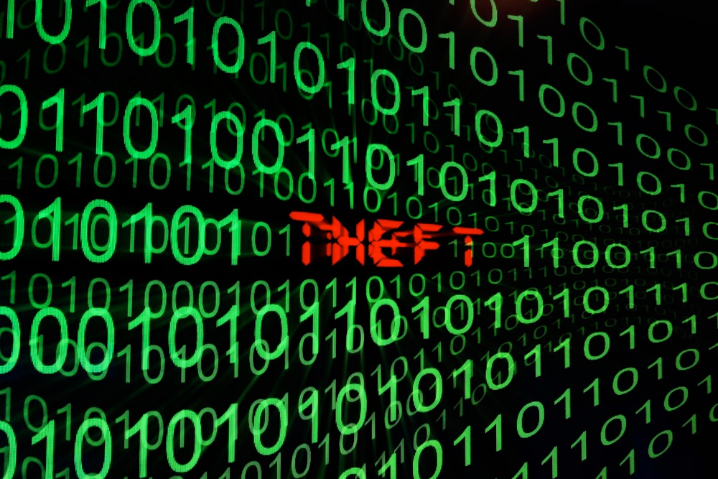
Cyber Theft
$ Mt.Gox’s bankruptcy caused significant loss for its users.
$ Criminal investigations and lawsuits never stopped.

Slide 24
$_Ransomeware_$
$ Ransomeware is another kind of terrible risk contributed by the Bitcoin.

Slide 25



CS1102
MA12XX
CLA1X02
CB240X
GE1X01

Slide 26



Most fantastic course
CS1102

Slide 27
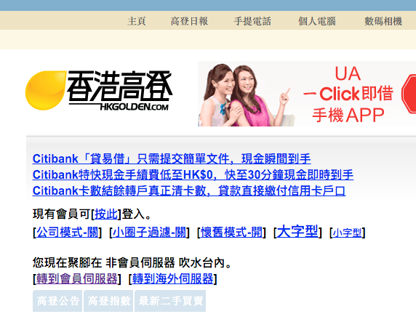

Slide 28
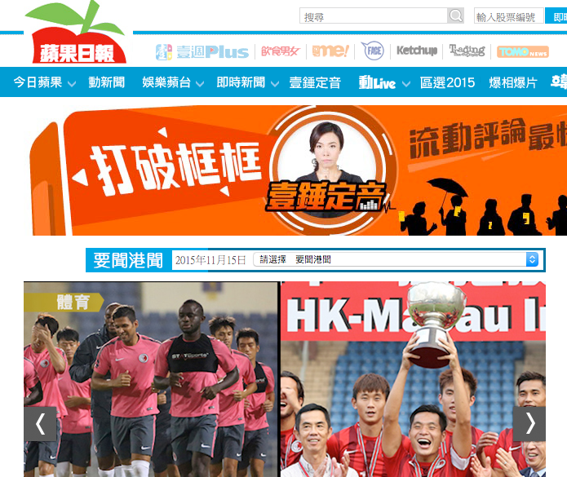

Slide 29
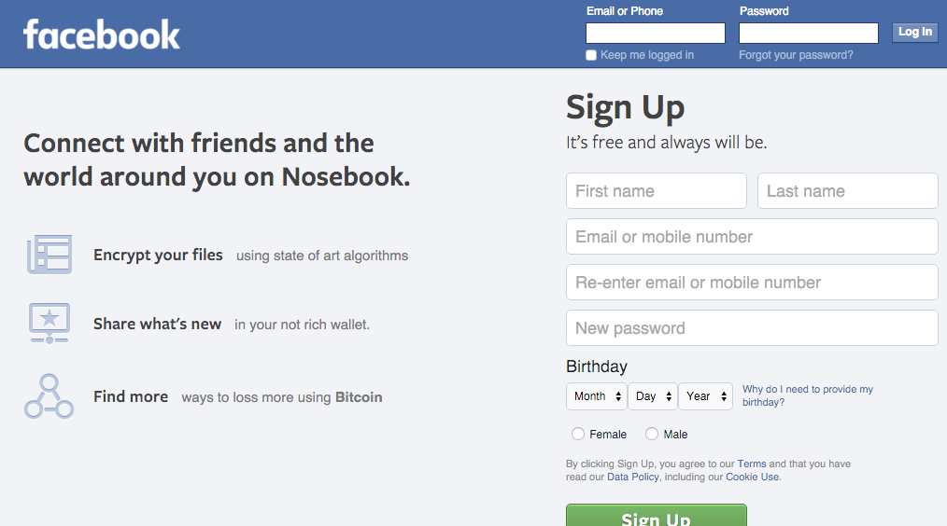
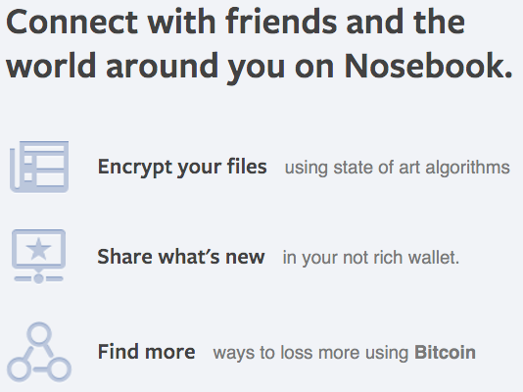

Slide 30
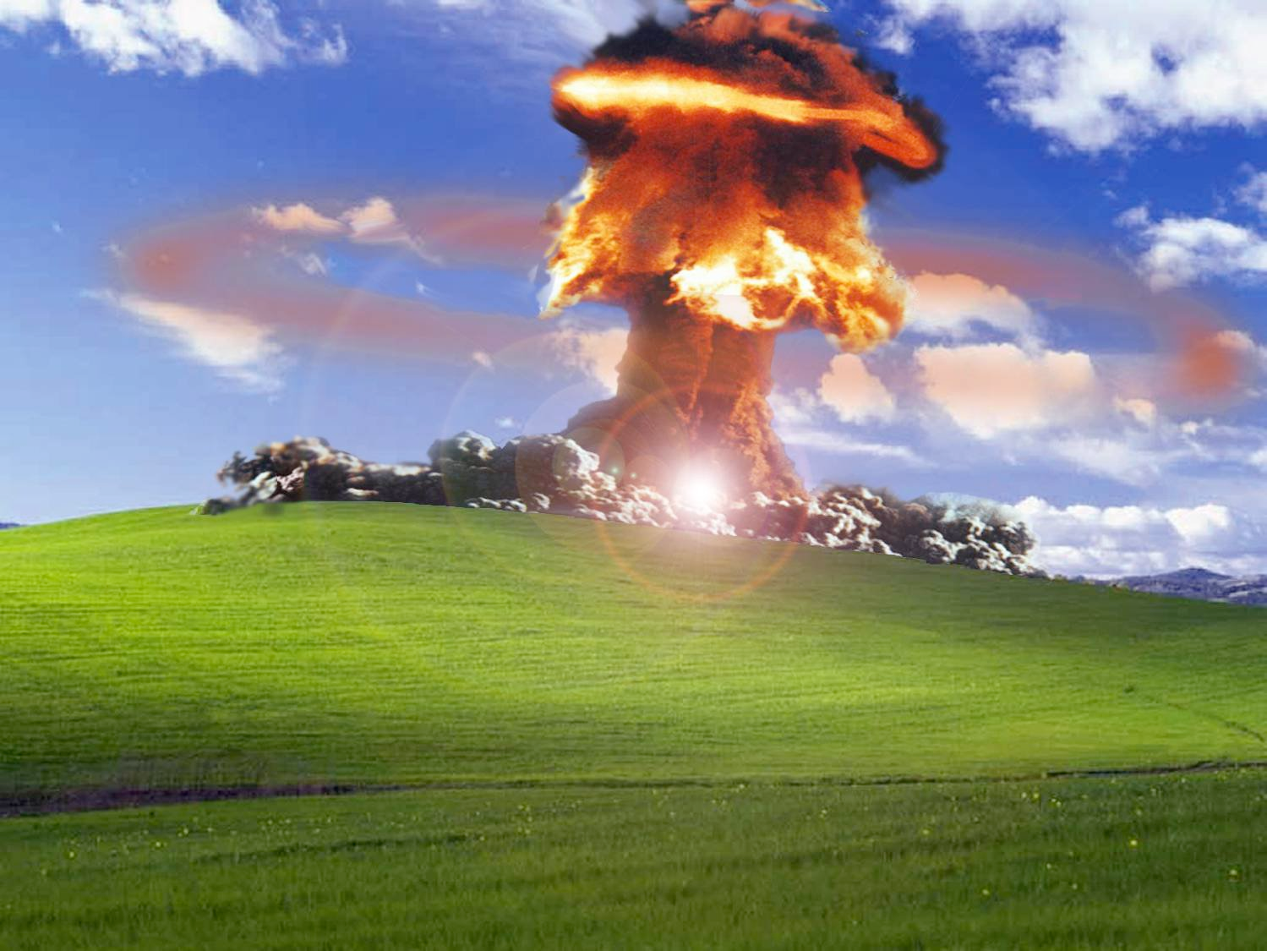

Slide 31
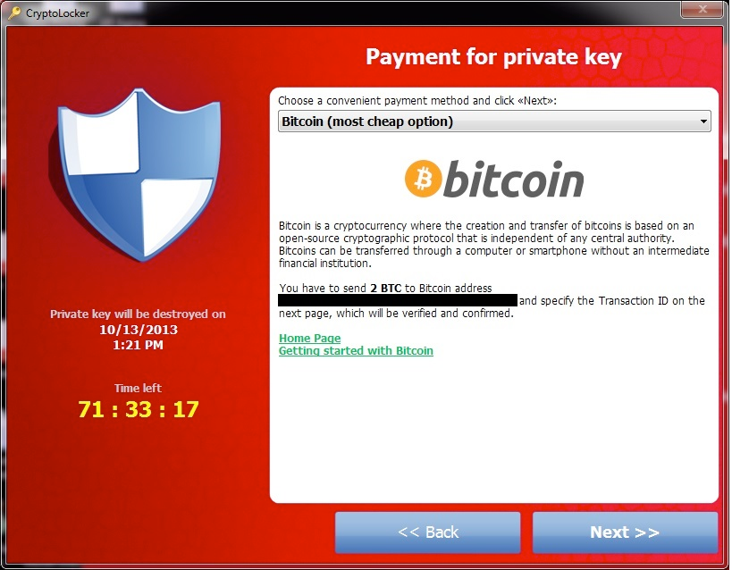

Proudly too old to go die

Slide 32
Proudly too old to go die

Slide 33
]
Lose approx. HKD8,000
Lose all Files
All your files
YOU

Slide 34
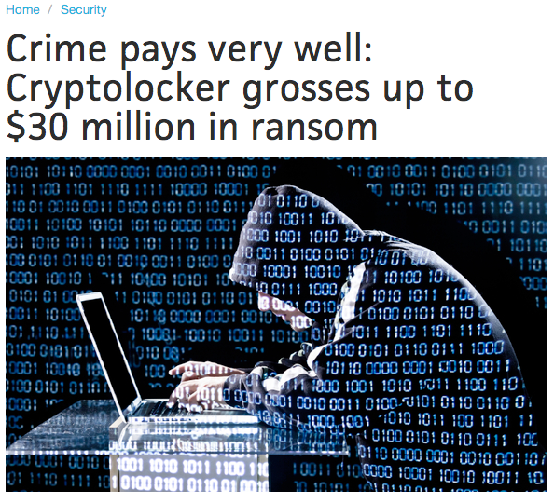
Cryptolocker
$ According to security experts, the creators of crypto
lockers and its copycats has made as much as 30 million USD in only 100 days, and>
http://www.pcworld.com/article/2082204/

Slide 35
… and its N.0
>Unfortunately, all of the criminals were hardly caught because of the anonymity of the Bitcoin.
http://www.pcworld.com/article/2082204/

Slide 36
~/Information Security Risks
$ Without effective preventing methods on cyber crime, it will be never secure enough for investors’ assets to be store on the internet.
$ The anonymity of the BitCoin to some extent increases the risk for people to gain lost in cyber crimes.

Slide 37
~/Financial Risks
$ Basic ideas

Slide 38
Volatility - Basic Ideas
Ups and Downs in price are always mentioned as the /RISK/ of a financial asset

Slide 39
Volatility - Basic Ideas
Ups and Downs in price are always mentioned as the /RISK/ of a financial asset
Bitcoin is a financial asset

Slide 40
Volatility - Basic Ideas
Ups and Downs in price are always mentioned as the /RISK/ of a financial asset
Bitcoin is a financial asset
Bitcoin has volatility in its price

Slide 41
Volatility - Basic Ideas
Ups and Downs in price are always mentioned as the /RISK/ of a financial asset
Bitcoin is a financial asset
Bitcoin has volatility in its price
Actually the volatility of Bitcoin is

Slide 42
Volatility - Basic Ideas
Ups and Downs in price are always mentioned as the /RISK/ of a financial asset
Bitcoin is a financial asset
Bitcoin has volatility in its price
Actually the volatility of Bitcoin is extremely high

Slide 43
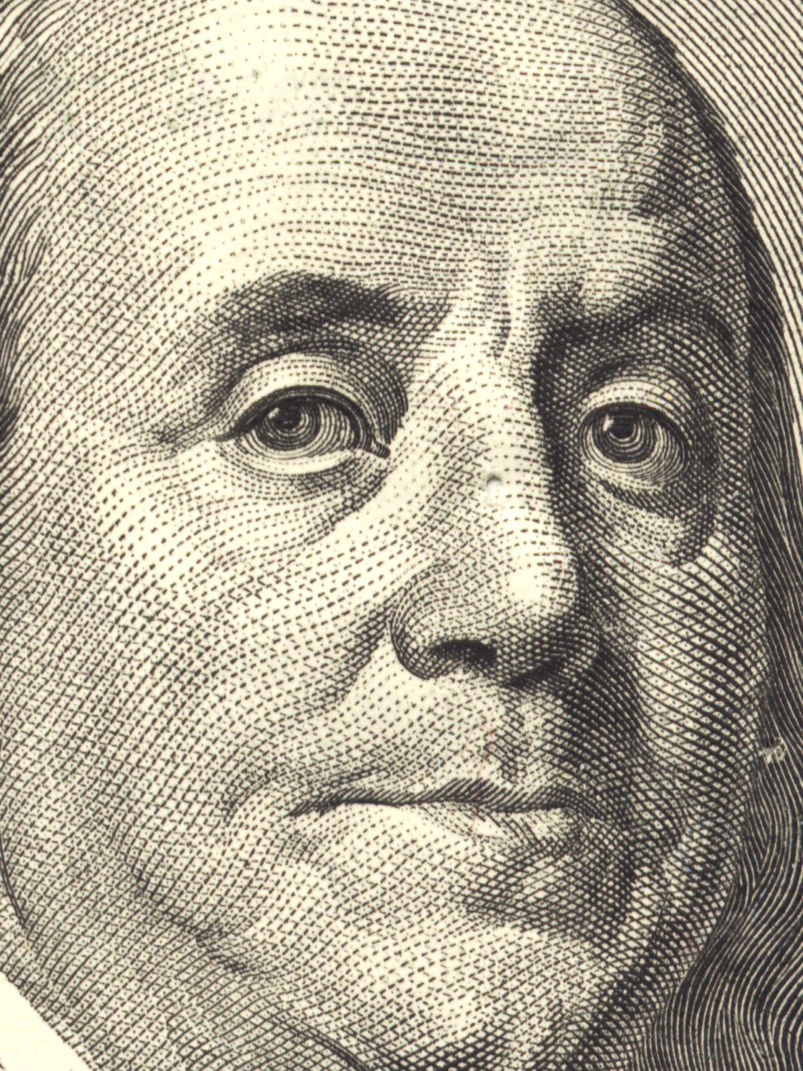
BTC/USD
323.361
-0.0000%
* The price shown above is delayed. Photos of currencies are just for representation purpose, and its copyright is subject to authorities.

Slide 44
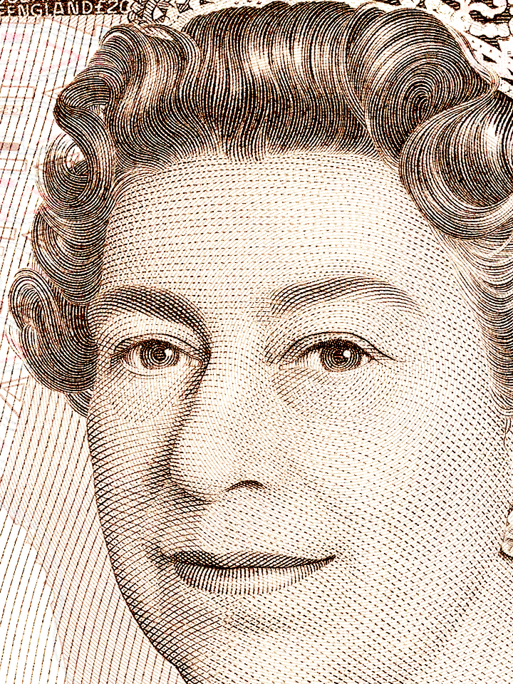
BTC/GBP
213.26
213.27
+0.0020%
+0.0021%
* The price shown above is delayed. Photos of currencies are just for representation purpose, and its copyright is subject to authorities.

Slide 45
BTC/HKD
2511.86
+0.0000%
* The price shown above is delayed. Photos of currencies are just for representation purpose, and its copyright is subject to authorities.

Slide 46
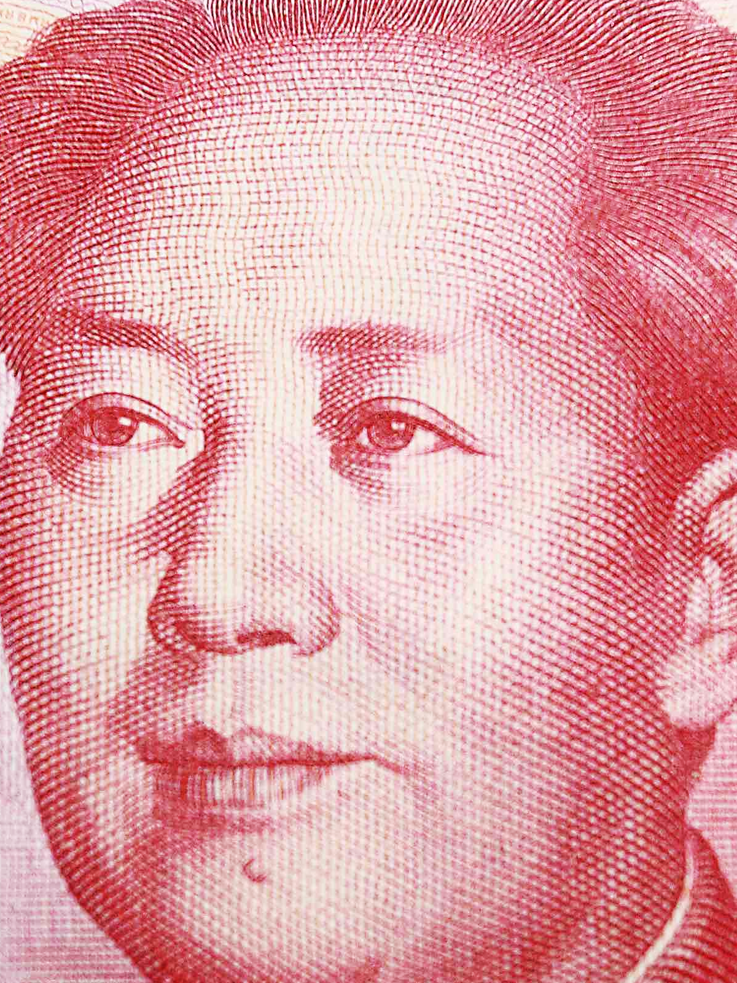
BTC/CNY
2096.21
+0.0110%
* The price shown above is delayed. Photos of currencies are just for representation purpose, and its copyright is subject to authorities.

Slide 47
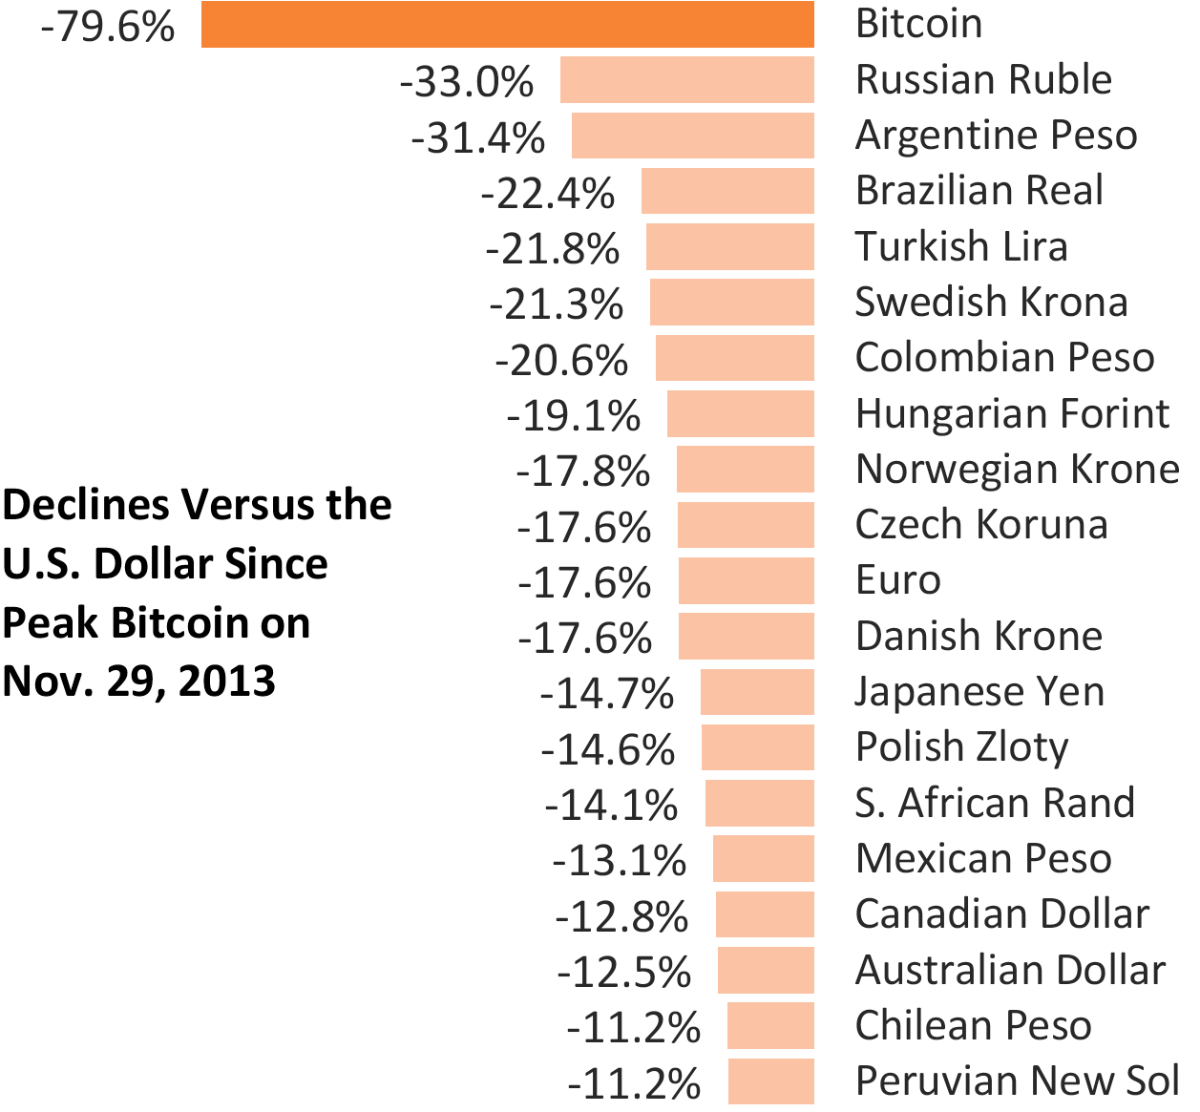
Volatility - For Example
$ The Russian economy could be the worst in these years because of sanctions.
$ Russian Ruble became 33% cheaper against USD.
Source: Bloomberg

Slide 48
Volatility - For Example
$ The Bitcoin dropped for nearly 80%, which was two times terrible than Russian Ruble.
$ The price is highly uncertain.

Slide 49
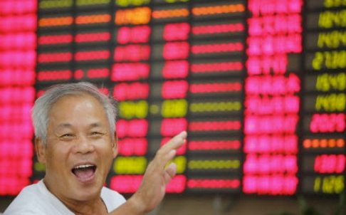
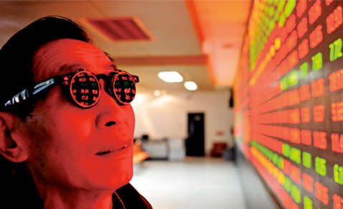
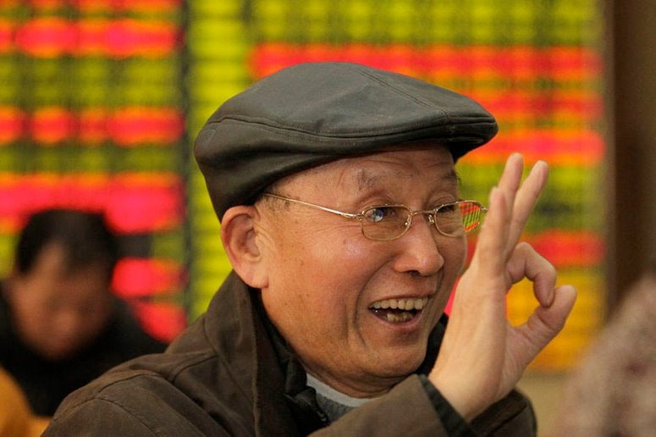
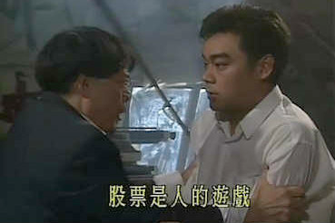
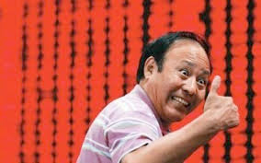
Great Bubble
$ The bubble underlying BitCoin is even far larger than the infamously famous Chinese stock market this year.

Slide 50
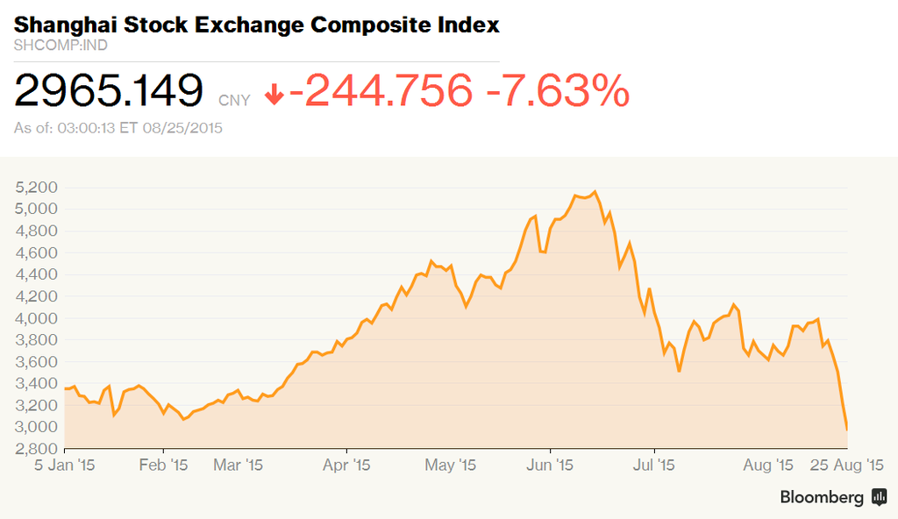
Great Bubble
$ SHCOMP Index rose about 50% within this year. The bubble boomed from 3,300 to 5,200, and busted in early Jun, wiped out more than 50% of investor’s wealth.

Slide 51
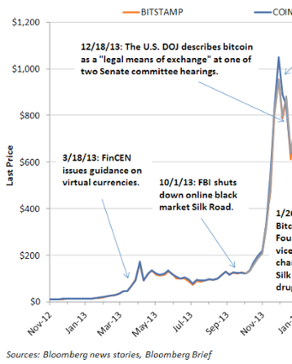
Great Bubble
$ The price increased for 100 times within one year, and dropped to 20% within another year.
Peaked at US$1147.25
US$11.04

Slide 52
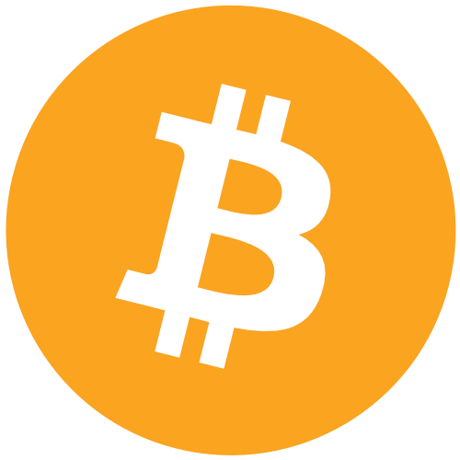
Great Bubble

Slide 53
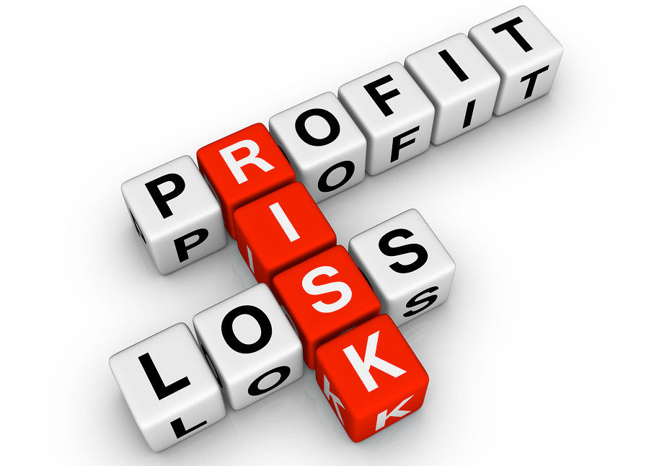
Great Bubble
Trading Bitcoins is much Much MUCH EXCITING risky than trading other stocks.
The extreme volatility may bring high profits, but meanwhile investors risk losing significant money in the market.

Slide 54
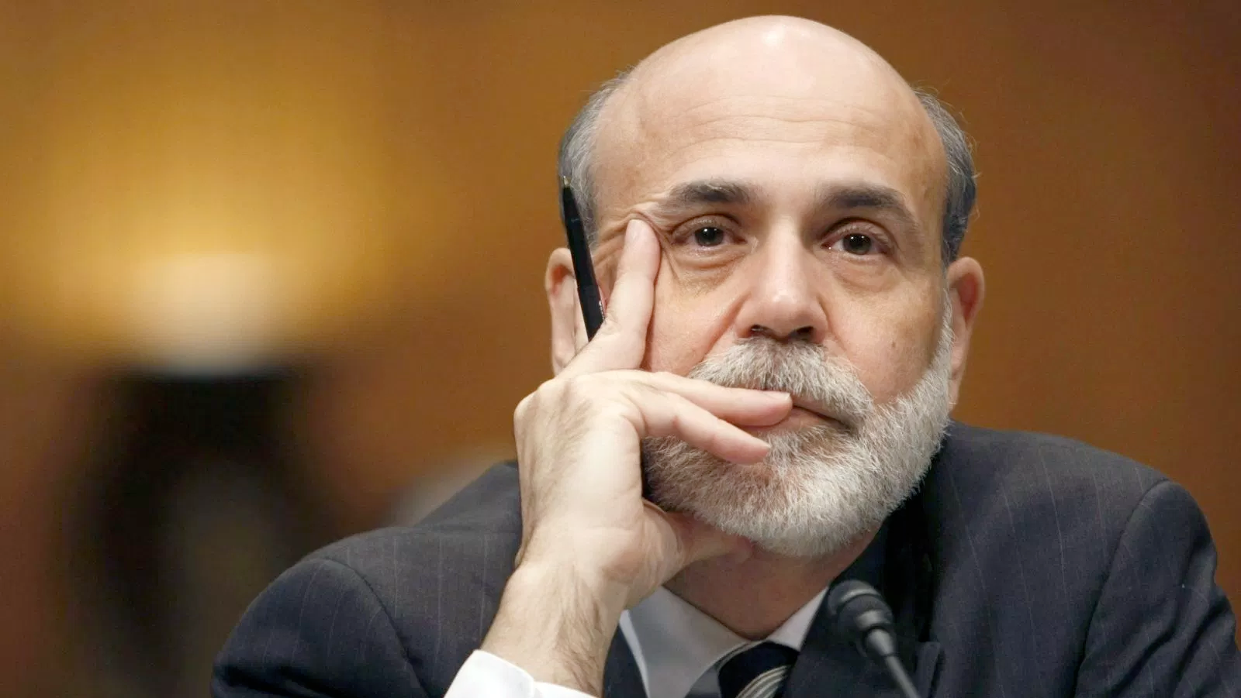
Lack of Endorsement
The serious problem of Bitcoin is that it hasn’t shown to be a stable source of value. Its price has been highly volatile and it hasn’t yet established itself as a widely accepted transactions medium.
Ben Bernanke, Ex-Chair of the Fed

Slide 55
~/Social Risks
./Money Laundering
./Real Life Crime
./Underground Economy

Slide 56
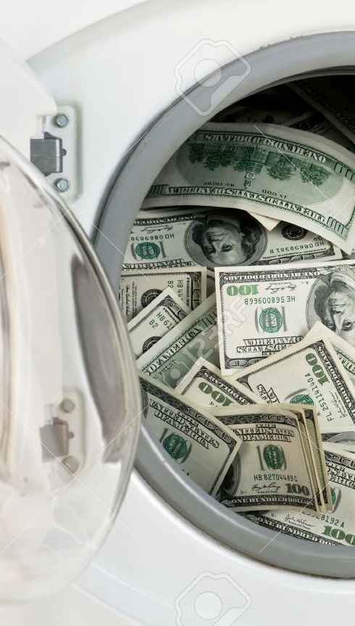
Money Laundering
$ Bitcoin network proceeds more than 1 million bitcoin transfers everyday, which worth more than 4 Billion HK$.
$ The anonymity of Bitcoin makes money laundering much secure.

Slide 57
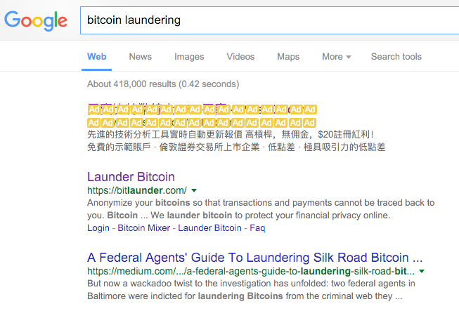
Money Laundering
$ For more information, just Google Bitcoin Laundering. All top results are service providers, and will make the process much more easier.

Slide 58
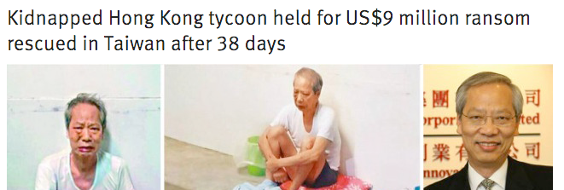
Real Life Crimes
Recently a Hong Kong tycoon was kidnapped.
The kidnapper asked for Bitcoins because the payment is instant and anonymous.
Fortunately Mr. Wong was finally rescued.

Slide 59
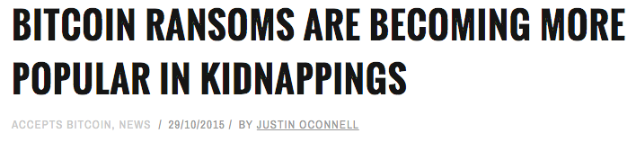
Real Life Crimes
Bitcoin is becoming more and more popular in conducting crimes and cleaning the dirty money. It posses a great risk to the stability of the whole society.

Slide 60
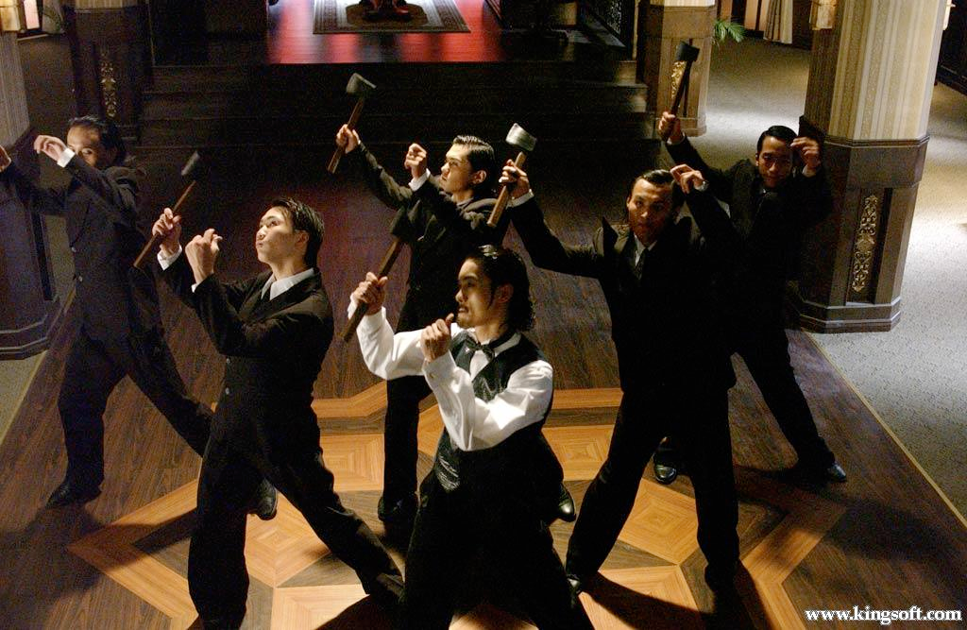
Underground Economy
Illegal groups like the Triad…

Slide 61
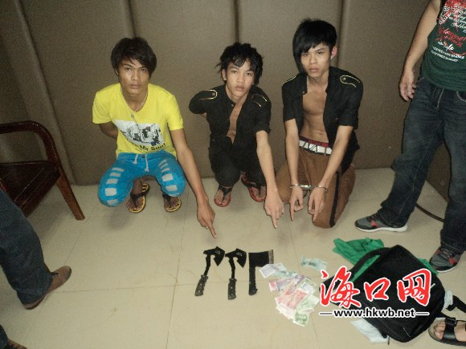
Underground Economy
Illegal groups like the Triad are easily got caught because their member have to be physically present when making illegal deals.

Slide 62
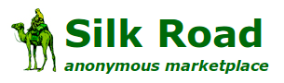
Underground Economy
Snapshot Censored
Online illegal marketplaces emerged: An anonymous trading platform for illegal goods and services, including drugs, stolen credit cards, fake cash, fake identification, and whatever you can imagine.

Slide 63

Underground Economy
$ The invention of Bitcoin directly supported the establishment of the Silk Road and other online illegal market place.
AND BITCOIN

Slide 64
Underground Economy
Without proper regulation, the Bitcoin’s philosophy of deregulation will expose a great risk in social security and stability.
AND BITCOIN

Slide 65
Social Risks
The real serious risk that Bitcoin has is it’s anonymity, which is a feature, and is also a fatal bug, in that it has become a vehicle for illegal transactions, drug selling or terrorist financing.
Citizens and governments are not happy to let that activity happen.

Slide 66
Wrap Up
The benefits and concepts offered by this digital currency are revolutionary. If the governments can find a balanced territory between strict regulation and absolute freedom by taking the cream and discarding the dross, we believe the technology could benefit much more to our lives.

Slide 67
Contribution
ZOU, Luoyi 54017313 100%
CHAU, Tsz Yau 53053443 100%
CHENG, Ka Yi 54297110 100%

Slide 68
http://www.coindesk.com/information/what-can-you-buy-with-bitcoins/
https://bitcoin.org/en/bitcoin-for-businesses
https://bitcoin.org/en/innovation
http://www.newsbtc.com/2015/03/29/bitcoin-for-international-petroleum-trade/
https://en.bitcoin.it/wiki/Donation-accepting_organizations_and_projects

